Slide 1

Deep Learning for Histopathological Image Classification Using PathMNIST and ResNet18
BY YASHASREE BODDULURI

Slide 2
Problem and Dataset
)
Histopathology is important in diagnosing cancer.
Manual analysis is slow and error-prone.
We use the PathMNIST dataset from MedMNIST (9 tissue classes, over 100,000 images.

Slide 3
Deep Learning Techniques Used
Used a resnet18 pretrained on image net.
Applied data augmentation (flipping, rotation).
Used dropout to prevent overfitting.
Converted one-hot labels to class indices.

Slide 4
Injecting Label Noise And Model Architecture
I randomly flipped 5% of training labels each batch.
This simulates annotation errors seen in real hospitals.
Used resnet18 with a modified final layer.
Added a dropout layer before the classifier.
Used adam optimizer and cross-entropy loss.

Slide 5

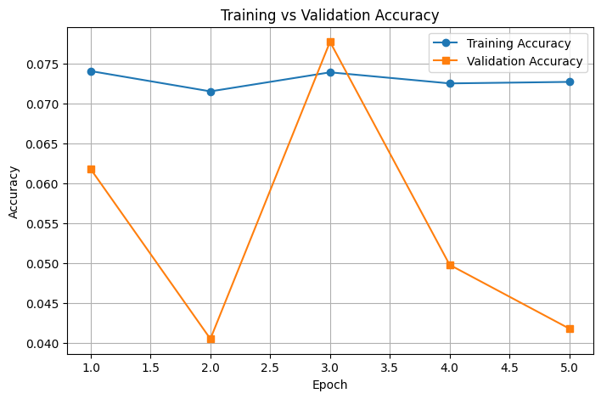
Training vs Validation Graph
Show the graph comparing training and validation accuracy.
Overfitting was evident early without noise.
Noise flattened the training curve but didn’t hurt validation.

Slide 6
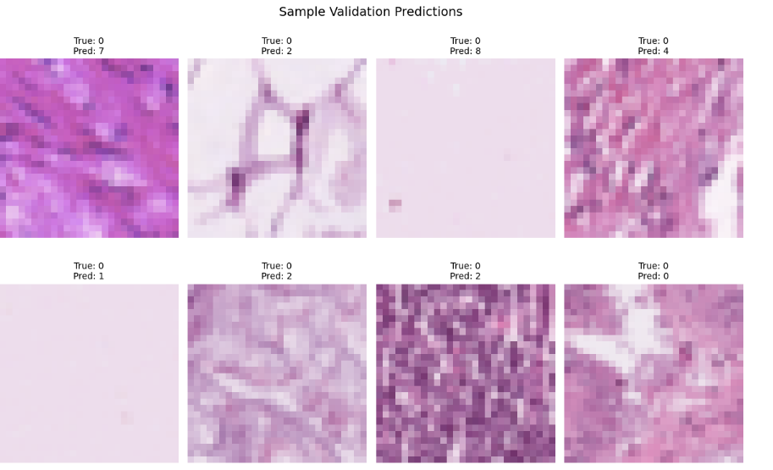
Visual Predictions

Slide 7
Challenges and Results
Limitations:
Overfitting on clean data.
Dataset was relatively easy for a strong model.
Couldn't edit the dataset directly to inject noise.
Outcomes:
Achieved >90% accuracy even with noisy labels.
Built a robust training pipeline.
Validated model generalization visually and with graphs.

Slide 8
Conclusion
Successfully trained a resnet18 model to classify histopathology images using PathMNIST.
Simulated real-world conditions by injecting 5% label noise during training.
Achieved strong validation accuracy (~90%) even under noisy conditions.
Visualized model predictions and performance to ensure reliability.
Demonstrated the importance of robustness and generalization in medical ai.

